Slide 1

Home page
The home page welcomes users, introduces the coffee shop, and highlights the main features and values. It provides navigation to all other sections.

Slide 2

About us
We are exciting about delivering the best coffee beans and coffee tools , blending tradition with quality. Our mission is to offer high-quality products and excellent service,.

Slide 3
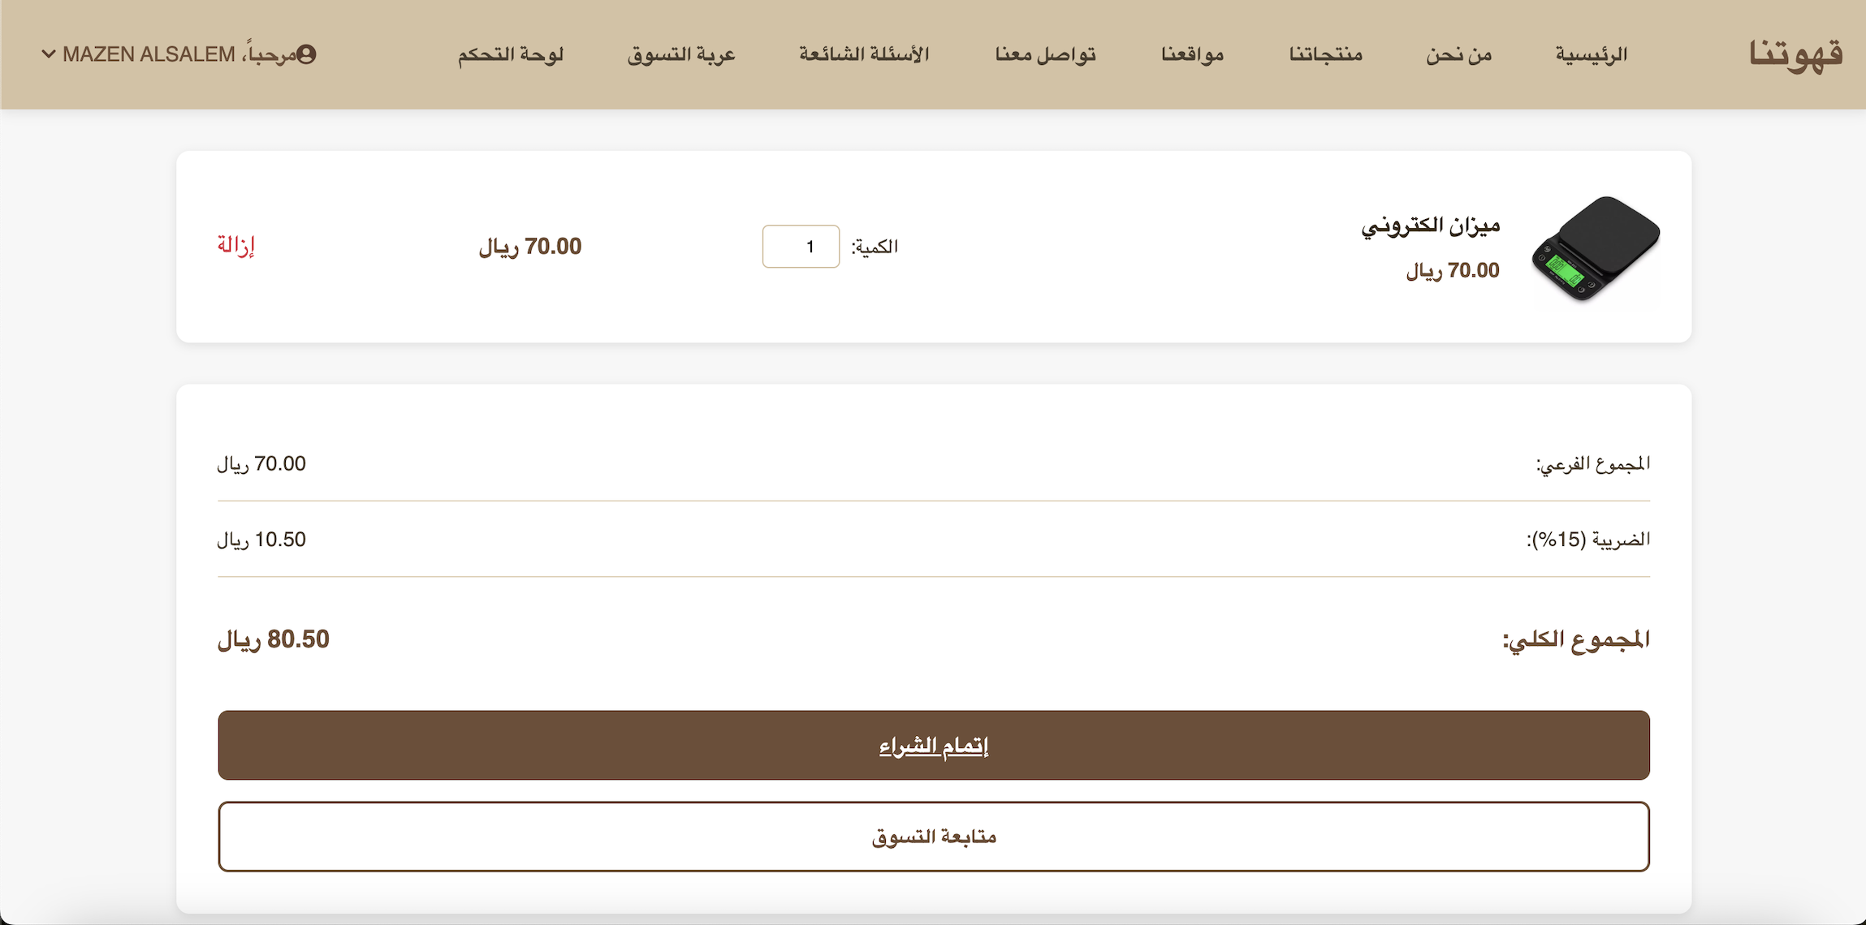
Shows all products the user intends to purchase, with options to update quantities, remove items, and proceed to checkout.
Cart page

Slide 4
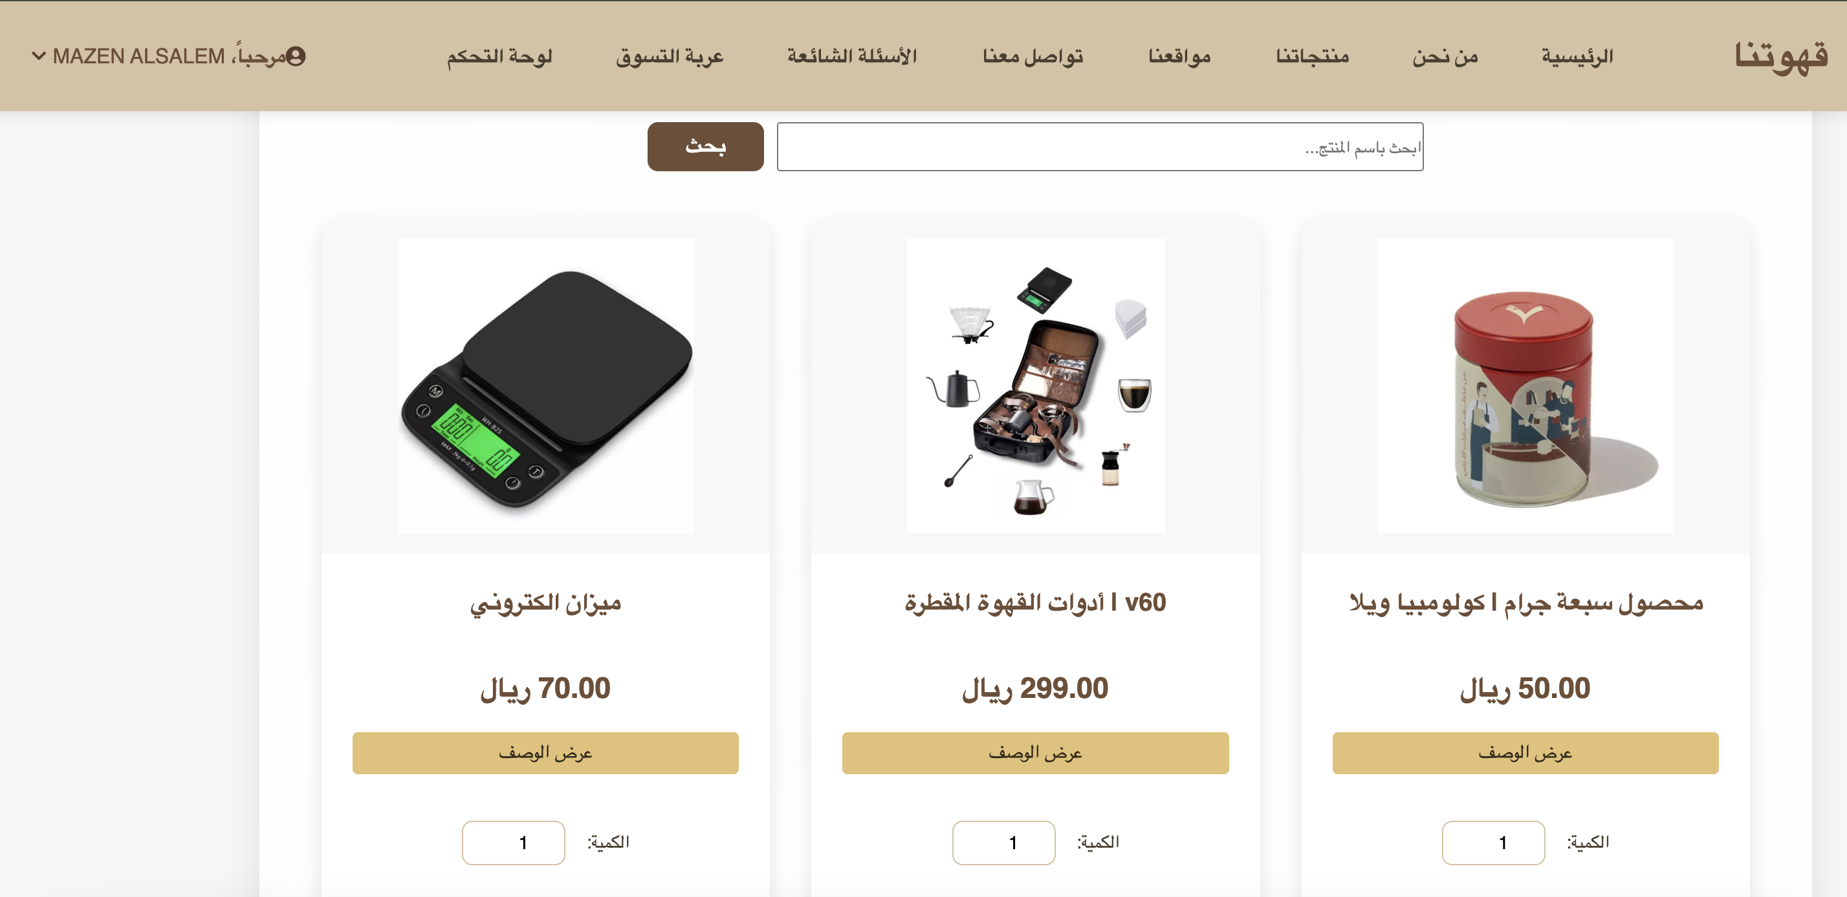
Displays all available products. Users can browse, search, and add products to their cart.
Products

Slide 5
Checkout Page
Users enter shipping and payment details to complete their purchase.

Slide 6
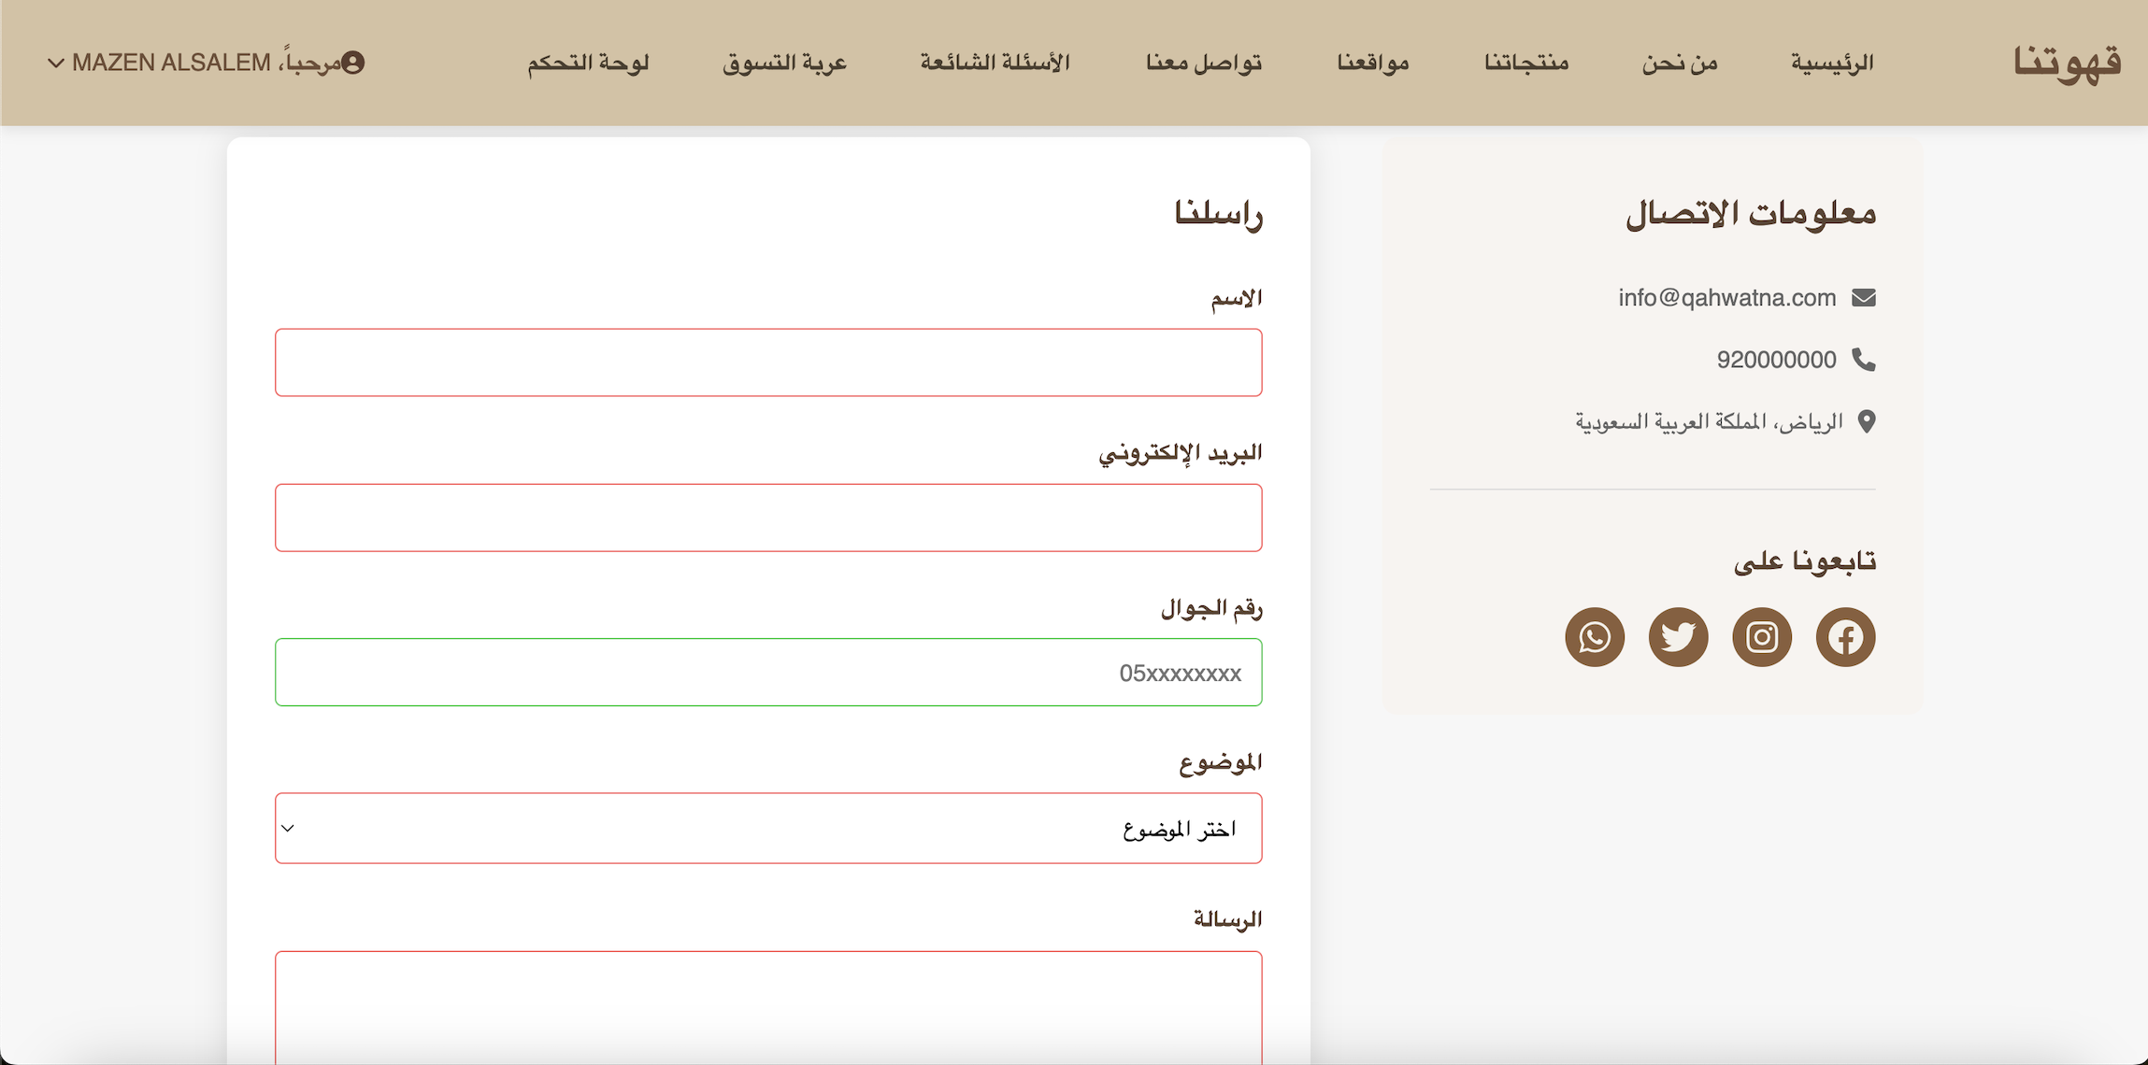
Users can send inquiries, suggestions, or complaints. A confirmation popup appears after submission.
Contact Us

Slide 7
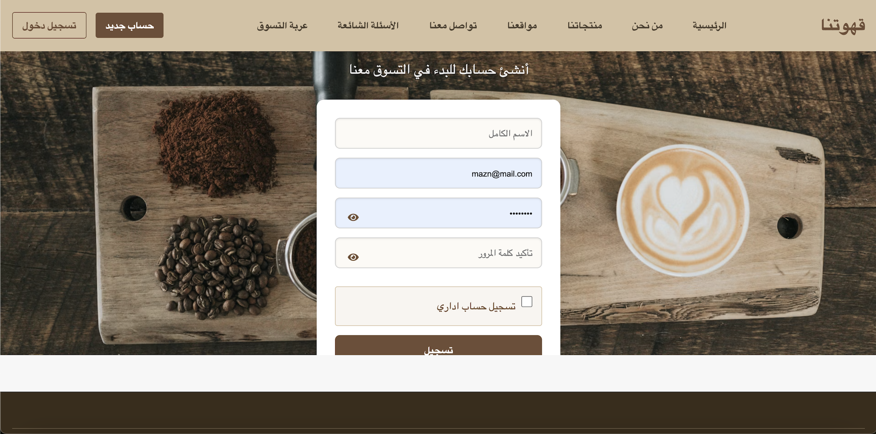
Allows users to log in or create a new account to access shopping and order features.
Login/Register

Slide 8
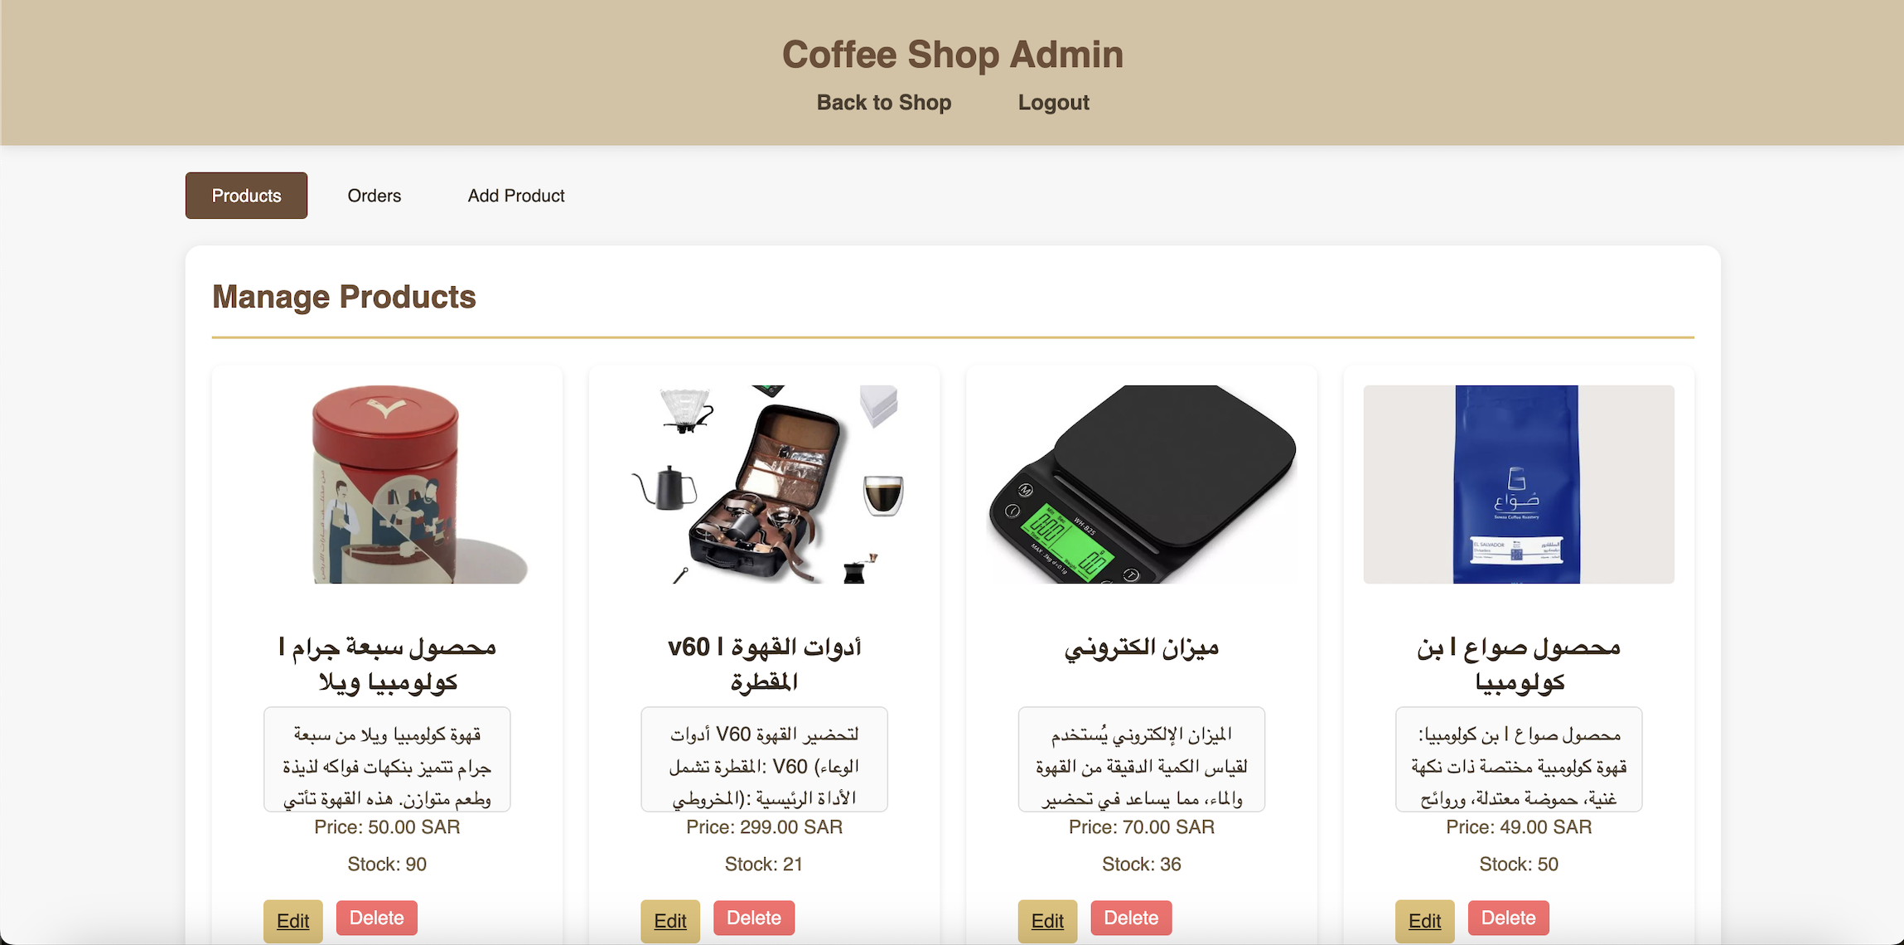
Accessible only to admins. Allows management of products and orders.
Admin Panel

Slide 9
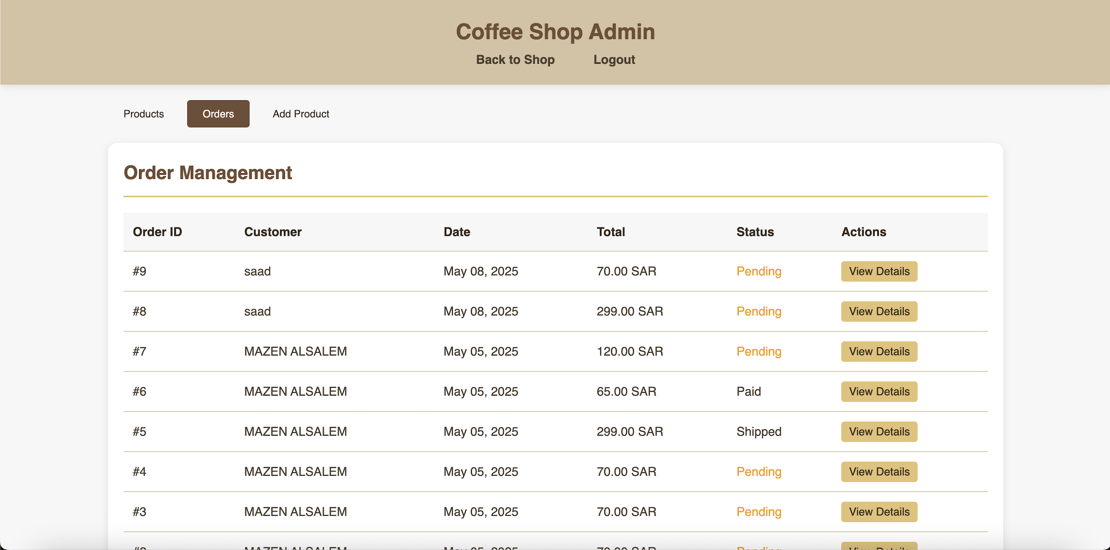
Admin - Manage Orders
Admins can view and update customer orders.

Slide 10
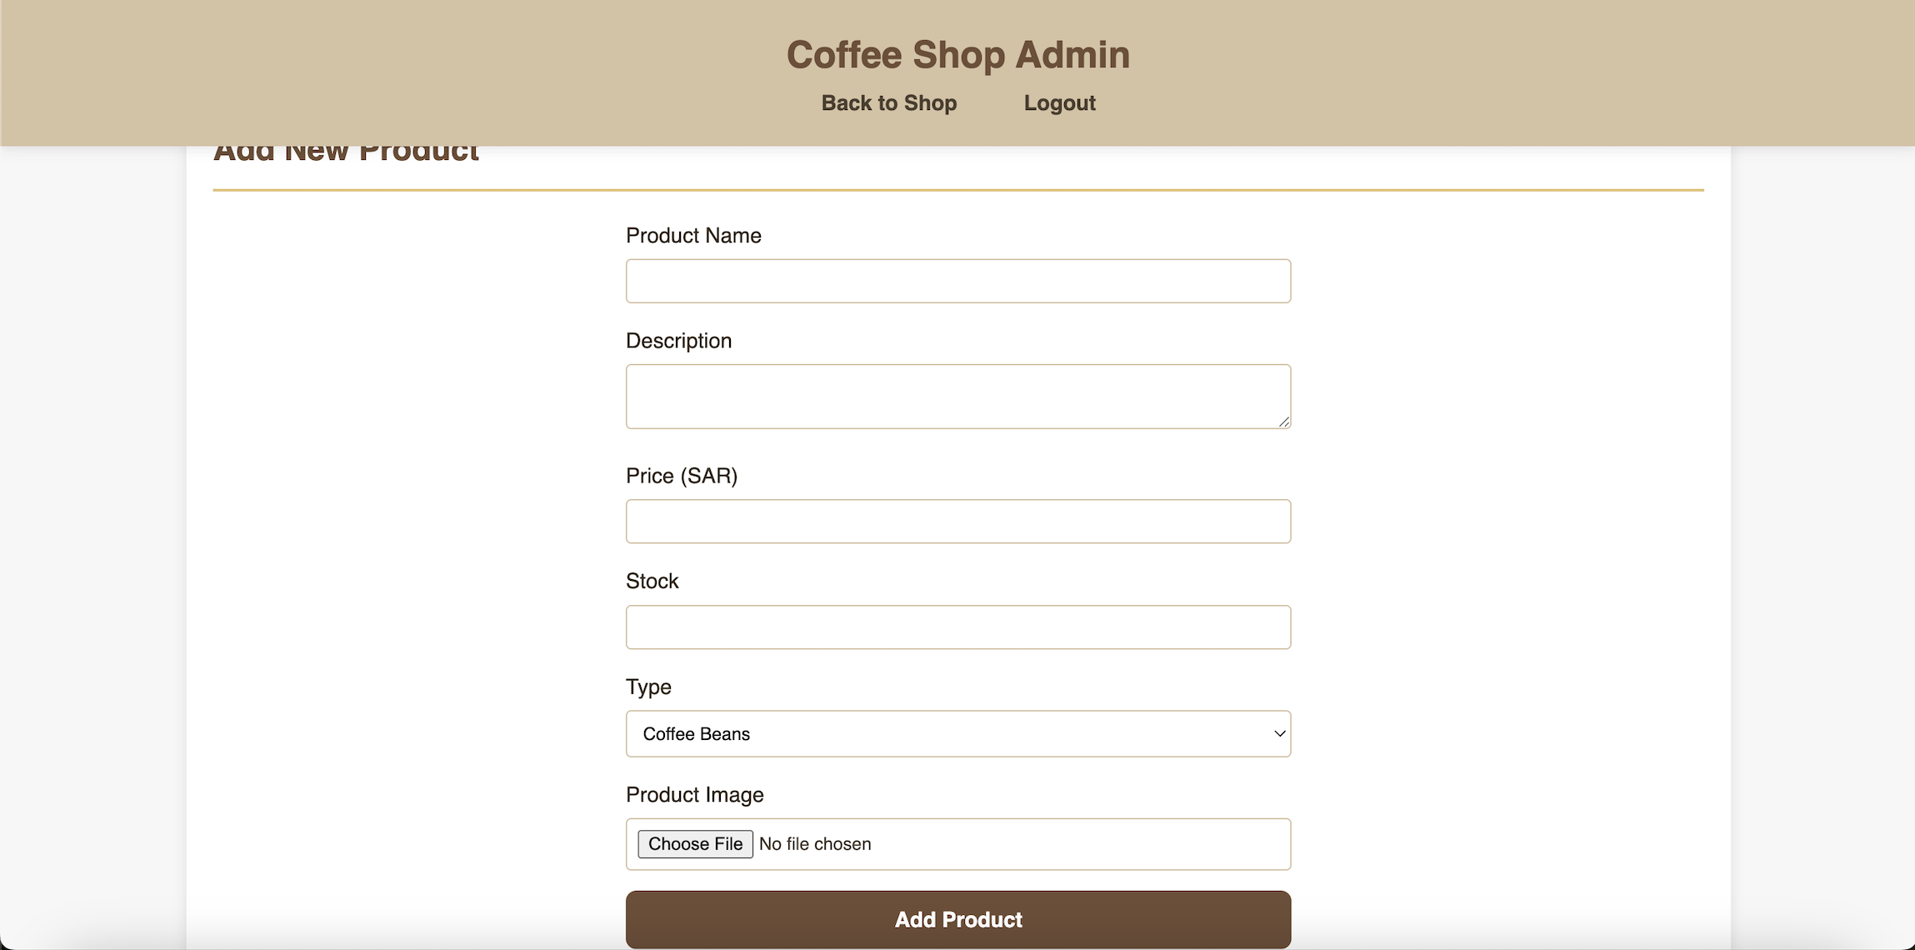
Admin - Add/Edit Product
Admins can add new products or edit existing product details.

